Slide 1
Power Aware Computing
Measurement, Control, and Performance Analysis for Intel Xeon Phi

Slide 2
ABSTRACT
Power consumption is important in in design of data center.
Power efficiency is the major constraint in system designs.
Power and energy are the challenges poses by power efficiency.
In this analysis scientific benchmarks and set of representatives kernels are used.
Result and conclusion will help in achieving energy efficiency in computing algorithm.

Slide 3
INTRODUCTION (contd..)
Processor designs are getting effected due to Power, energy and temperature.
Stagnation of CPU clock frequencies and reliance on parallelism increase energy efficiencies of future.
Along with advancements in hardware, software advancements for energy efficiency is important too.
Software design can bring huge improvements in addition to the hardware.

Slide 4
INTRODUCTION (contd..)
Ability of measuring the power and energy consumption is mandatory step.
PAPI library was used in this analysis that give generic and portable interface to hardware counters attached to CPU and other components.
Experiments were executed on Intel Xeon Phi Knights Landing (KNL) architecture.
Analysis was performed using Dense Linear Algebra (DLA) Kernels.
Specifically BLAS kernels.

Slide 5
HARDWARE
Intel Xeon Phi Knights Landing processors offers 16 GB of High bandwidth Memory based on 425GB/s of bandwidth of MCDRAM, along with DDR4 memory of bandwidth 90 GB/s.
The MCDRAM can be configured in BIOS in one of three different usage modes. One is flat, second is cache and other is hybrid mode.
Experiment was conducted on three different configuration of MCDRAM on the kernel.

Slide 6
REPRESENTATIVE KERNELS
Kernels that can be found in high performance computing application were chose to study and analyze the effect of application of power consumption and energy requirements.
For low level linear algebra operations BLAS is specific for it.
BLAS operations are categorized in three levels Level 1: It addresses scalar and vector operations. Level 2: It addresses matrix-vector operation Level 3: It addresses matrix-matrix operations.

Slide 7
REPRESENTATIVE KERNELS
BLAS routine is ideal for examining the power and performance characteristics.
Level 1 and Level 2 belongs to Memory Bond Class.
Whereas Level 3 belongs to Compute Intensive Class.
Presented the study and to analyze the compute intensive routine dgemm and memory bound class dgemv.
As it provides wide range of computational intensities.

Slide 8
PAPI: The PERFORMANCE API
PAPI performance library provides a coherent methodology to performance counter information varied for different hardware and software component.
Power Monitoring Capabilities
PAPI offers many components which enables to monitor power usage and consumption of energy through different interfaces like Intel RAPL (Running Average Power Limit) and MicAccess API.

Slide 9
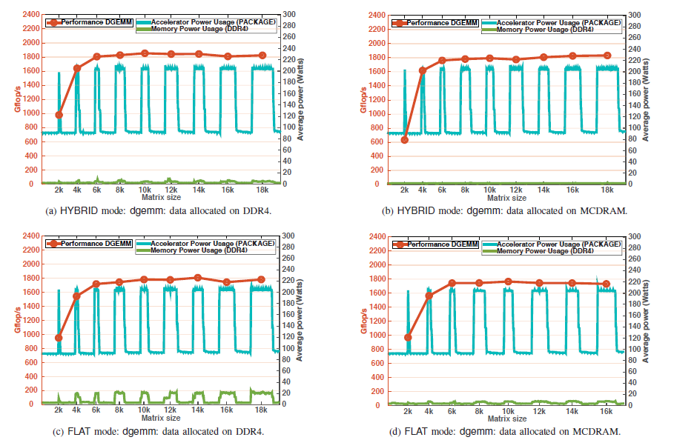
Study of dgemm Kernel Behaviour

Slide 10
Study of dgemm Kernel Behavior (contd..)
Figure a shows when KNL is booted in HYBRID and the data is allocated in DDR4.
Figure b shows when data is allocated in MCDRAM.
Figure c and d shows the measurements for dgemm when the KNL is booted in FLAT mode.
The FLAT mode does not use the MCDRAM as a cache, but as physical addressable memory space

Slide 11
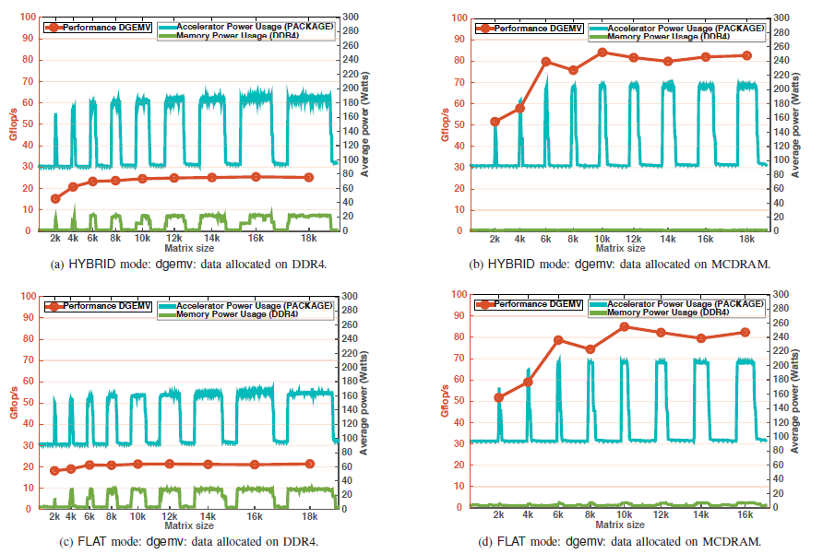
Study of dgemv Kernel Behaviour

Slide 12
Study of dgemv Kernel Behaviour
Figure a and b illustrates the results for the Hybrid Mode because kernel is memory bound and cache reuse benefits are limited.
Performance drops dramatically between the two storage.
Figure c and d illustrates the results for Flat Mode.
Results are observed same as of Hybrid Mode except for DDR4. For which performance is 4 times slower as compared to MCDRAM.

Slide 13
CONCLUSION
This study allowed us explore power management and capping strategies matching the computational intensities which leads to energy saving.
Using high bandwidth MCDRAM on KNL is important for achieving high performances and minimal consumption of power.
Behavior of these kernels were explored while booting configuration of MCDRAM on KNL.
If the application is compute intensive than Hybrid mode is best, in either case memory bound option is best and allocate the data in MCDRAM.

Slide 14
Cited Work
https://ieeexplore.ieee.org/abstract/document/8091085/

